Slide 1


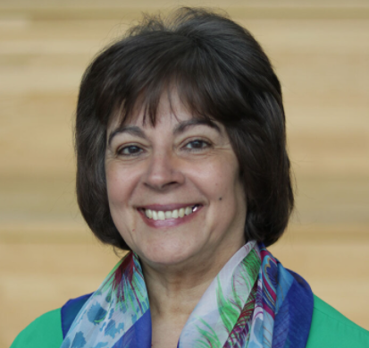
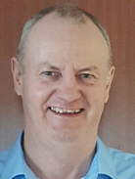

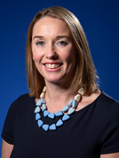
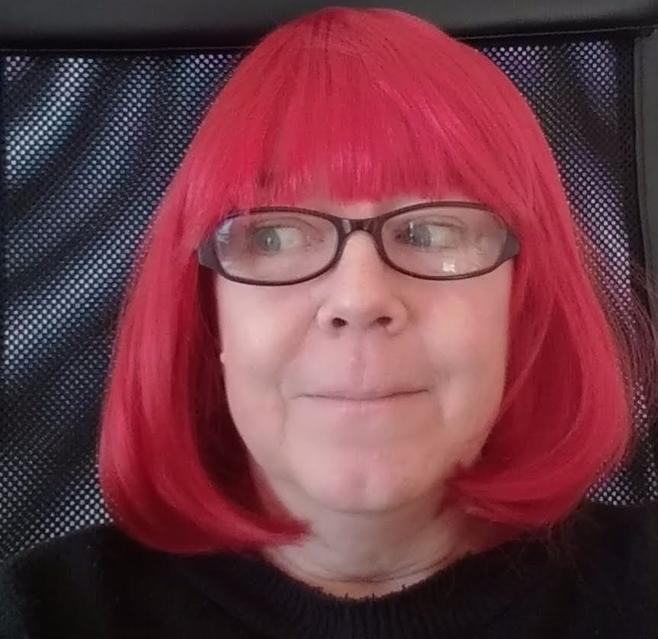







One day conference
28th April 2022
Attend in person at:
Manchester Metropolitan University
Hybrid event
Online
OR
In person
Brooks Building
Hulme
Manchester
M15 6GX
The HALT Research Team would like to welcome you to our end of project conference to share findings from our ESRC funded study on Domestic Homicide.
Workshops include:
Adult Family Homicide
Black and Minoritised Victims and Perpetrators
DHR processes
Female Perpetrators
Speakers and panellists include:
Professor
Khatidja Chantler,
ManMet
Frank Mullane MBE,
CEO AAFDA
Nicole Jacobs,
Domestic Abuse Commissioner
Detective Chief Superintendent Michaela Kerr
Davina
James-Hanman,
DHR Chair
Talks, films, poetry, workshops and a roundtable discussion, including:
Experiences of families who have lost a relative to domestic homicide
Experiences of victims/survivors of domestic abuse
Professionals perspectives on the domestic homicide reviews (DHRs)
The HALT study’s analysis of the DHRs
To register, download the Whova app or click: https://whova.com/web/haltc_202204/
(Grant reference ES/S005471/1)

